Slide 1
Ideal Unclamping Order at Carotid Endarterectomy Procedures: Ex-Vivo Study
Mahmut SASANI ¹, Bekir INAN ²
¹ Bezmialem Vakif University, School of Medicine, Istanbul, Turkey
² Bezmialem Vakif University, Faculty of Medicine, Department of Cardiovascular Surgery, Istanbul, Turkey
Bezmialem Vakif University
June, 2021

Slide 2
Plan
Introduction
Carotid Stenosis (Carotid Artery Disease)
Carotid Endarterectomy
Importance and Aim of Study
Material and Method
Results
Conclusion
Acknowledgement

Slide 3
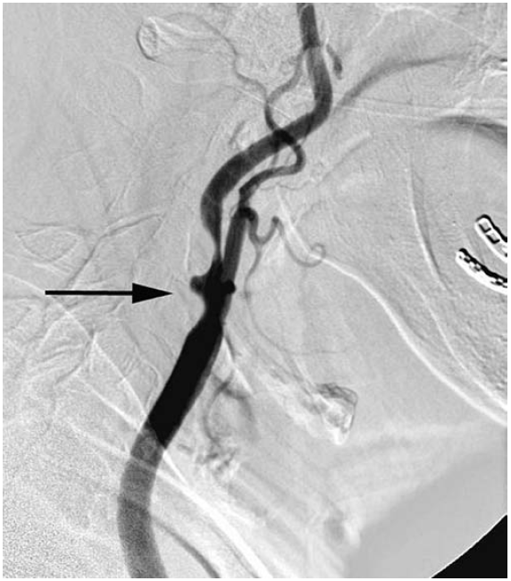
Carotid Stenosis (Carotid Artery Disease)
Internal Carotid Artery
(ICA)
Most common pathology
Related to 60% of ischemic strokes
External Carotid Artery
(ECA)
Common Carotid Artery
(CCA)
Schaser KD, et al. Noninvasive analysis of conjuctival microcirculation during carotid artery surgery reveals microvascular evidence of collateral compensation and stenosis-dependent adaptation. Journal of Vascular Surgery 2003;37:789-797
Lin, P.H., Poi, M.J., Matos, J., et al. Arterial Disease, F. Charles Brunicardi, et al. Schwartz's Priciples of Surgery, 10th ed. the United States, McGraw-Hill Education, 2015, pg. 827

Slide 4
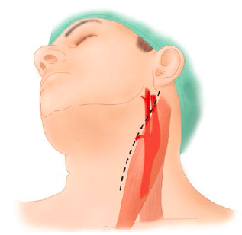
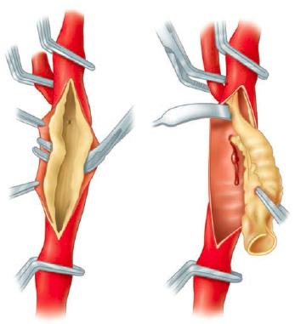
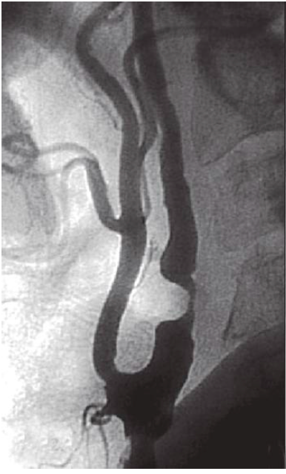
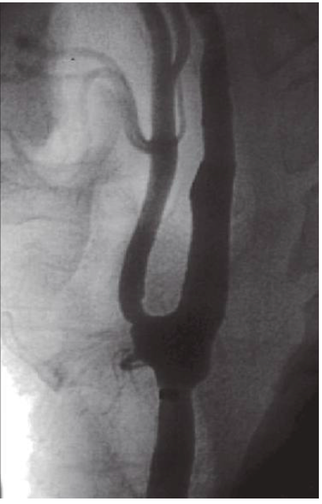
Carotid Endarterectomy (CEA)
Carotid Endarterectomy is a standard procedure for carotid artery stenosis.
70–99% stenosis Perform CEA
K.M. Erickson, D.J. Cole, Carotid artery disease: stenting vs endarterectomy, British Journal of Anaesthesia, Volume 105, Supplement 1, 2010, Pages i34-i49, ISSN 0007-0912, https://doi.org/10.1093/bja/aeq319.
Longmore, M. Wilkinson, I.B., Baldwin, A. Wallin, El. Neurology, I. B. Wilkinson, T. Raine, K. Wiles, et al. Oxford Handbook of Clinical Medicine,10th ed. UK, Oxford University Press, 2017, pg. 444
Lin, P.H., Poi, M.J., Matos, J., et al. Arterial Disease, F. Charles Brunicardi, et al. Schwartz's Priciples of Surgery, 10th ed. the United States, McGraw-Hill Education, 2015, pg. 827

Slide 5
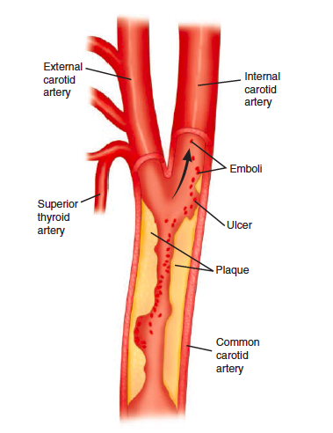
Importance of Research
Higher than 70% stenosis of the carotid artery poses a significant risk for stroke
The risk of perioperative embolism has shown to be 1-3%.
Operative dissection, air bubble, shunt insertion, clamp release
Unclamping procedure is one of the most critical stages
Different authorities use different sequences.
There is no consensus.
K.M. Erickson, D.J. Cole, Carotid artery disease: stenting vs endarterectomy, British Journal of Anaesthesia, Volume 105, Supplement 1, 2010, Pages i34-i49, ISSN 0007-0912, https://doi.org/10.1093/bja/aeq319.
Longmore, M. Wilkinson, I.B., Baldwin, A. Wallin, El. Neurology, I. B. Wilkinson, T. Raine, K. Wiles, et al. Oxford Handbook of Clinical Medicine,10th ed. UK, Oxford University Press, 2017, pg. 444
Lin, P.H., Poi, M.J., Matos, J., et al. Arterial Disease, F. Charles Brunicardi, et al. Schwartz's Priciples of Surgery, 10th ed. the United States, McGraw-Hill Education, 2015, pg. 827
Wang X, Yang B, Ma Y, Gao P, Wang Y, Chen Y, et al. Comparison of monitoring of cerebral blood flow bt c-FLOW and transcranial doppler in carotid endarterectomy. World Neurosurgery 2018;111:686-692

Slide 6
Aim
To indicate an ideal order of unclamping the carotid arteries in order to prevent a cerebrovascular accident, emphasize this matter and be a reference to this necessity

Slide 7
Study Design
This study took place at the Department of Cardiovascular Surgery, Bezmialem Vakif University Hospital
November the 26th, 2020

Slide 8
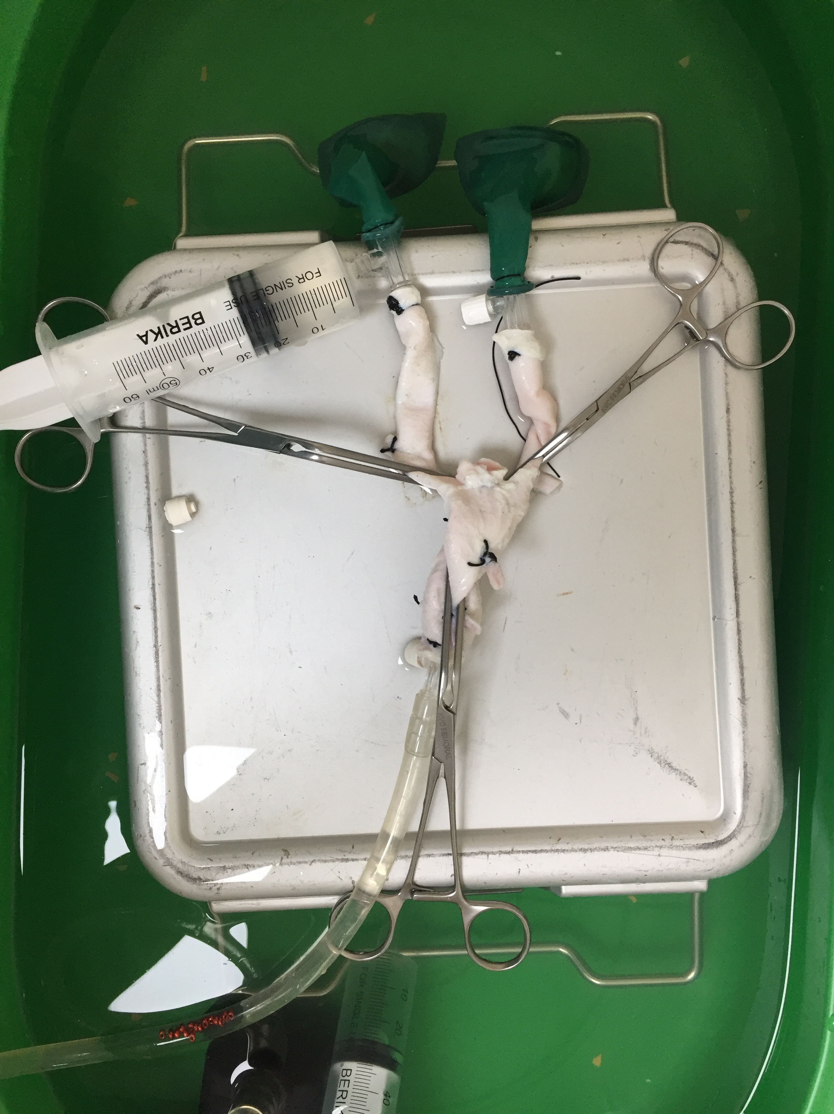
Materials and Methods
5 Bovine Aortic bifurcation (CCA-ICA-ECA)
Silk tie
Surgical basin (30x50 cm)
T and straight infusion connectors
Submersible pump
Transparent medical grade PVC Tube
Scouring sponges and balloons
15 beads (remnant tissue)
60 ml injector
Vascular clamps

Slide 9
Internal Carotid Artery (ICA)
Common Carotid Artery (CCA)
T and straight infusion connectors
Surgical basin (30x50 cm)
Scouring sponges and balloons
Vascular clamps
Submersible pump
15 beads
60 ml injector
External Carotid Artery (ECA)
Transparent medical grade PVC Tube
A total of 3 vessels were used due to deformation for this procedure

Slide 10
Combinations
Study Combinations:
C-1 (CCA-ICA-ECA)
C-2 (CCA-ECA-ICA)
C-3 (ICA-CCA-ECA)
C-4 (ICA-ECA-CCA)
C-5 (ECA-CCA-ICA)
C-6 (ECA-ICA-CCA)
Textbook combination:
C-7 (Rutherford) (ICA-CCA-ECA-ICA)

Slide 11
Analysis of Data
SPSS (IBM Corp. Released 2019. IBM SPSS Statistics for Windows, Version 26.0. Armonk, NY: IBM Corp) for the analysis
Kruskal-Wallis Test
Pairwise comparisons were analysed with Dunn Bonferroni post hoc test
Descriptive statistics are given as median (min-max)
Level of significance α=0.05 was taken
Each combination was tested 10 times

Slide 12
Results (I)
Combinations | median(min-max) (n=15) | p-value
 | 4(1-7) | <0.001
Combination 1 (order; CCA-ICA-ECA) | 12.5(10-15) | 1C-2C 1C-3C 1C-4C 1C-5C 1C-6C 1C-7C | <0.001 1.000 0.001 1.000 0.188 <0.001
Combination 2 (order; CCA-ECA-ICA) | 3(0-5) | 2C-3C 2C-4C 2C-5C 2C-6C 2C-7C | <0.001 1.000 0.025 0.543 1.000
Combination 3 (order; ICA-CCA-ECA) | 11.5(8-14) | 3C-4C 3C-5C 3C-6C 3C-7C | 0.008 1.000 0.951 0.002
Combination 4 (order; ICA-ECA-CCA) | 4(2-6) | 4C-5C 4C-6C 4C-7C | 0.210 1.000 1.000
Combination 5 (order; ECA-CCA-ICA) | 9(3-13) | 5C-6C 5C-7C | 1.000 0.070
Combination 6 (order; ECA-ICA-CCA) | 7(1-13) | 6C-7C | 1.000
Combination 7 (order; ICA-CCA-ECA-ICA) | 4(0-6)

Slide 13
Results (II)
Due to the post hoc test results
Combinations | median(min-max) (n=15) | p-value
 | 4(1-7) | <0.001
Combination 1 (order; CCA-ICA-ECA) | 12.5(10-15) | 1C-2C 1C-3C 1C-4C 1C-5C 1C-6C 1C-7C | <0.001 1.000 0.001 1.000 0.188 <0.001
Combination 2 (order; CCA-ECA-ICA) | 3(0-5) | 2C-3C 2C-4C 2C-5C 2C-6C 2C-7C | <0.001 1.000 0.025 0.543 1.000
Combination 3 (order; ICA-CCA-ECA) | 11.5(8-14) | 3C-4C 3C-5C 3C-6C 3C-7C | 0.008 1.000 0.951 0.002
Combination 4 (order; ICA-ECA-CCA) | 4(2-6) | 4C-5C 4C-6C 4C-7C | 0.210 1.000 1.000
Combination 5 (order; ECA-CCA-ICA) | 9(3-13) | 5C-6C 5C-7C | 1.000 0.070
Combination 6 (order; ECA-ICA-CCA) | 7(1-13) | 6C-7C | 1.000
Combination 7 (order; ICA-CCA-ECA-ICA) | 4(0-6)

Slide 14
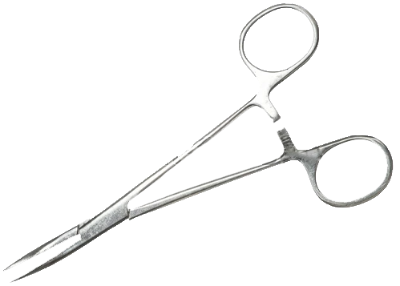
Conclusion
ECA
ICA
Aim: To indicate an ideal order of unclamping the carotid arteries in order to prevent a cerebrovascular accident, emphasize this matter and be a reference to this necessity
In this study, C-2 (CCA-ECA-ICA) was found to be statistically more significant than the other combinations.
This was the first experimental study on this subject.
3
2
1
CCA
More complex, live animal models
Significance on animal model
Patients?

Slide 15
Acknowledgement
Bekir Inan, M.D.
Özlem Toluk
Assistant Professor
Bezmialem Vakif University, Faculty of Medicine, Department of Cardiovascular Surgery
Research Assistant
Bezmialem Vakif University, Faculty of Medicine, Department of Biostatistics and Medical Informatics

Slide 16
Thanks for your attention
Correspondence:
Mahmut Sasani
Bezmialem Vakif University,
School of Medicine
sasanimahmut@gmail.com

